Slide 1
EDA of Spotify Songs from 1920- 2020
Group 16 : Fangru Linghu , Yiming Tan , Siyu Chen , Arun Mishra
Data of Presentation : 24/04/2023
Group 16 : Fangru Linghu , Yiming Tan , Siyu Chen , Arun Mishra

Slide 2


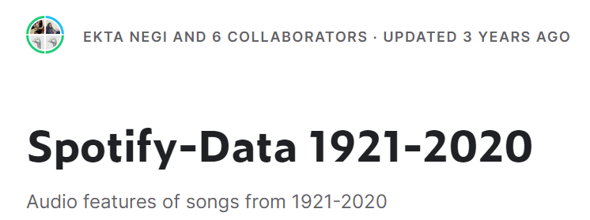
Introduce
→ What is Spotify ?
Spotify is a digital music, podcast, and video service that gives you access to millions of songs and other content from creators all over the world.
→ What we did?
In this project, we analyzed the distribution of musical features such as danceability, energy, loudness, liveliness, valence, and duration, as well as their changes across different decades.
We also ranked the popular artists of each decade.
→ Data Source
Data in this report is extracted from Kaggle-Spotify-Data 1921-2020, which contains the top 100 songs in each year from 1921-2020 in Spotify (totally 169k songs) as the description.
Sentiment Analysis of Popular Songs' Lyrics
Group 16 : Fangru Linghu , Yiming Tan , Siyu Chen , Arun Mishra

Slide 3
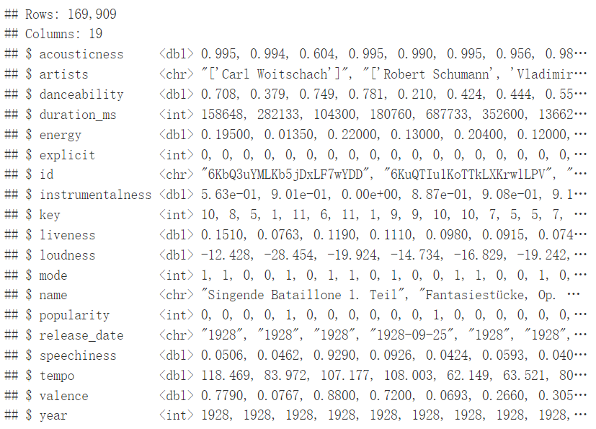
About Original Dataset
The file of dataset contains more than 160.000 songs collected from Spotify Web API. The dataset is from Spotify and contains 169k songs from the year 1921 to year 2020. Each year got top 100 songs.
→ bring data into R
duration_ms
Need to be modified…
year
Need to be modified…
Sentiment Analysis of Popular Songs' Lyrics
Group 16 : Fangru Linghu , Yiming Tan , Siyu Chen , Arun Mishra

Slide 4
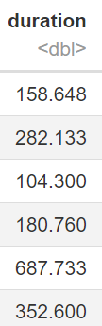
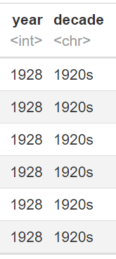
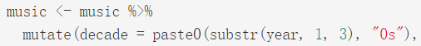
Pre-process of Data
→ bring data into R
→ Convert the duration from milliseconds to seconds.
duration_ms
duration_s
Output
Code
→ Assign each song to its corresponding decades
Output
year
decades
Code
Sentiment Analysis of Popular Songs' Lyrics
Group 16 : Fangru Linghu , Yiming Tan , Siyu Chen , Arun Mishra

Slide 5
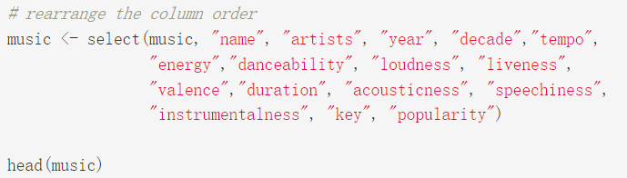
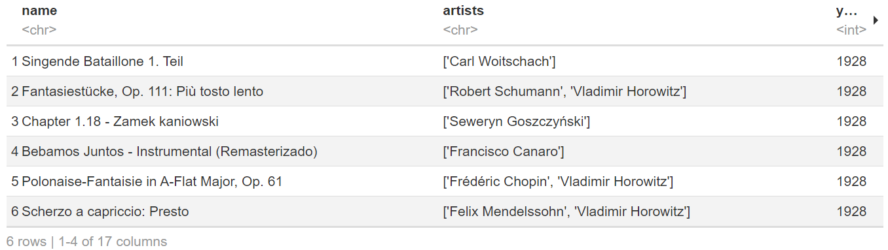
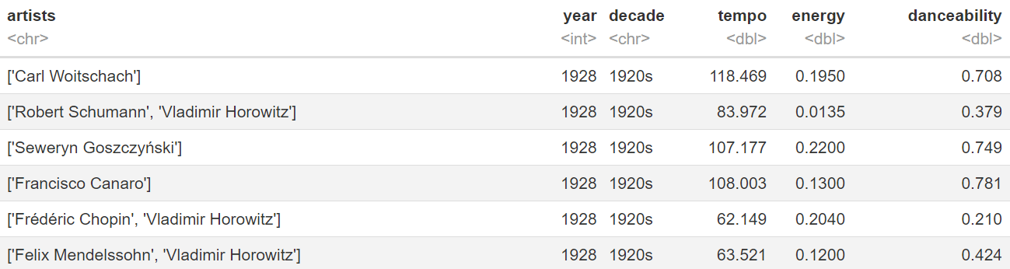
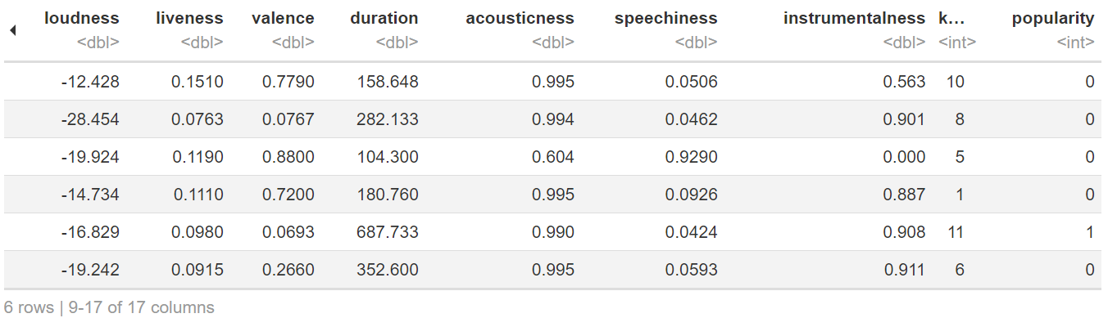
Clean Data and Tidy Data
→ Select variables what we need
Now we have…
Drop those we do not need
Summary of the data…
Sentiment Analysis of Popular Songs' Lyrics
Group 16 : Fangru Linghu , Yiming Tan , Siyu Chen , Arun Mishra

Slide 6
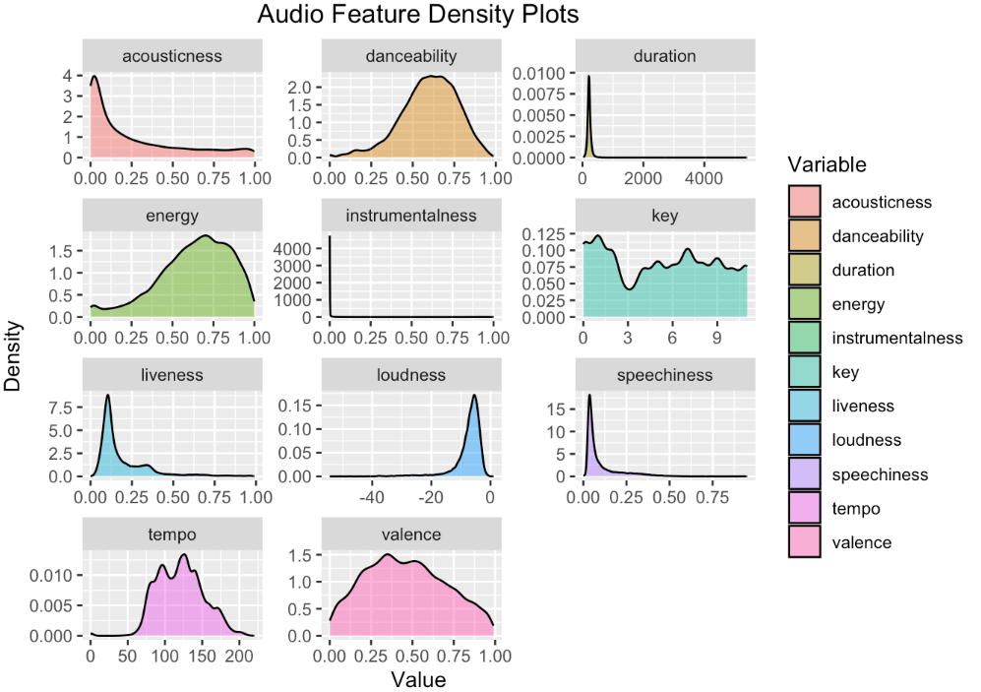
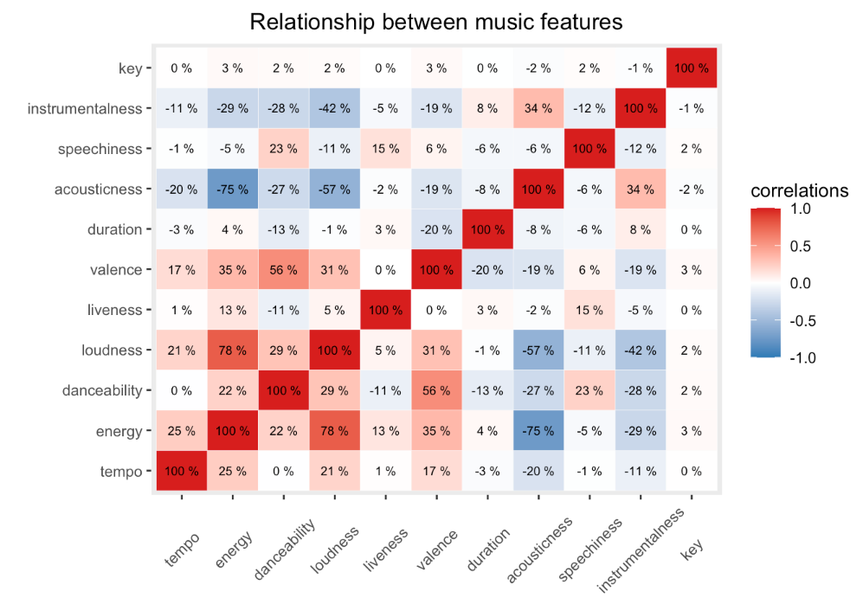
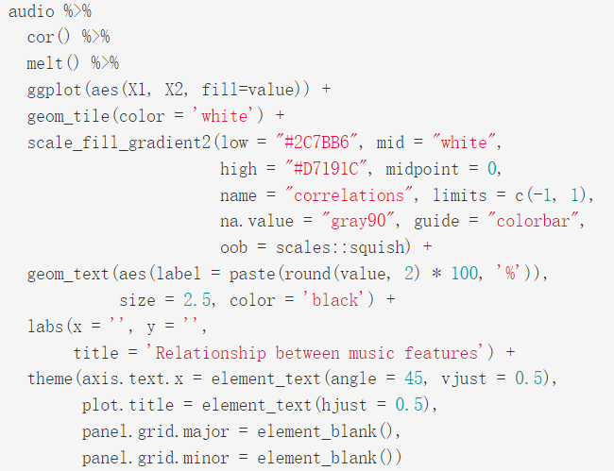
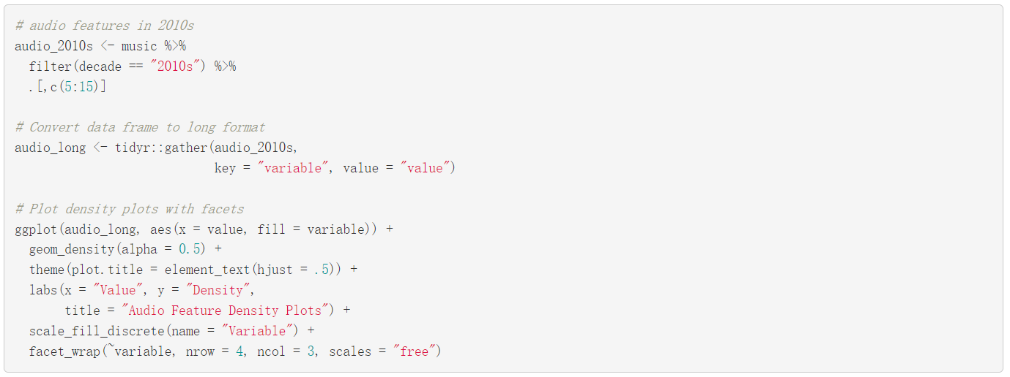
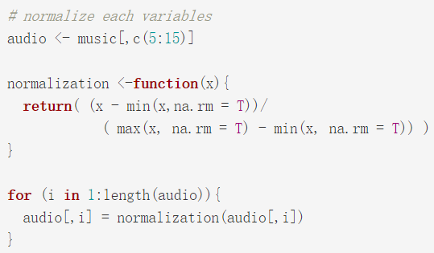
Comparison among variables and Relationship between each two variables
Code Review
→ Step 2 : tile plot
Code Review
→ Density plots with facets
→ Step 1 : Normalizing
Sentiment Analysis of Popular Songs' Lyrics
Group 16 : Fangru Linghu , Yiming Tan , Siyu Chen , Arun Mishra

Slide 7
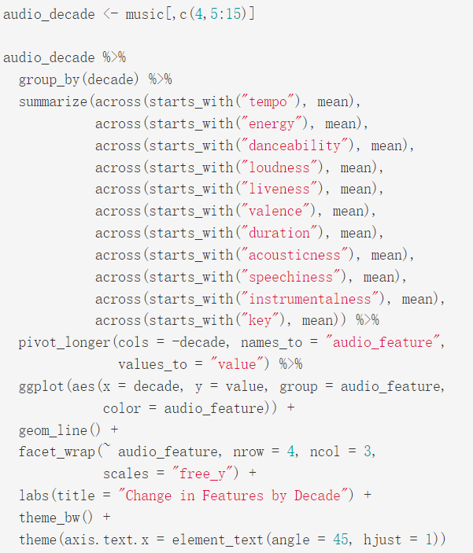
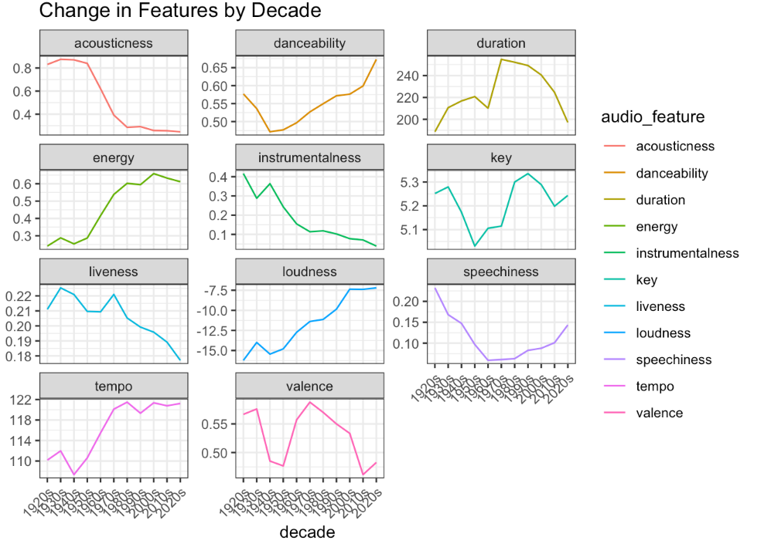
Changes from 1921 to 2020
Code Review
→ Line plots
Sentiment Analysis of Popular Songs' Lyrics
Group 16 : Fangru Linghu , Yiming Tan , Siyu Chen , Arun Mishra

Slide 8
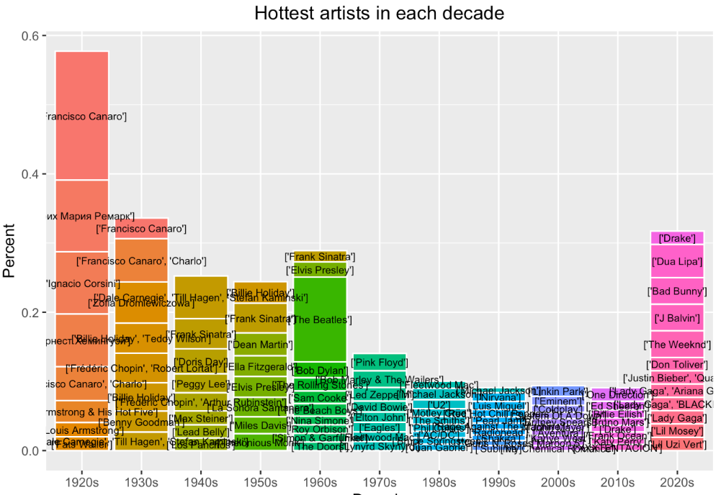
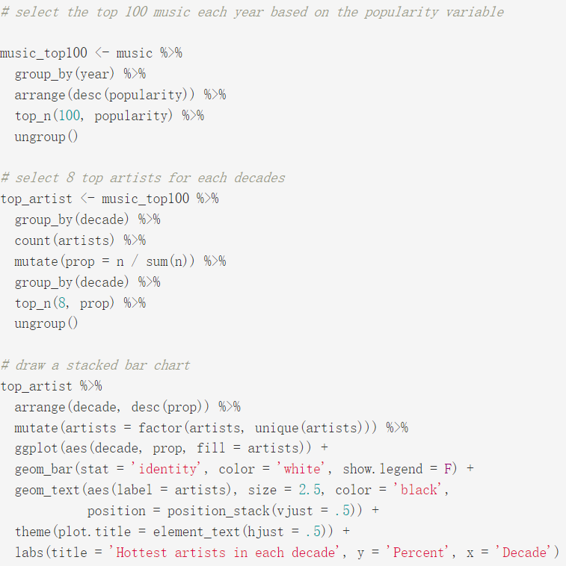
Rank of popular artists of each decade
Code Review
→ bar graph
Sentiment Analysis of Popular Songs' Lyrics
Group 16 : Fangru Linghu , Yiming Tan , Siyu Chen , Arun Mishra

Slide 9
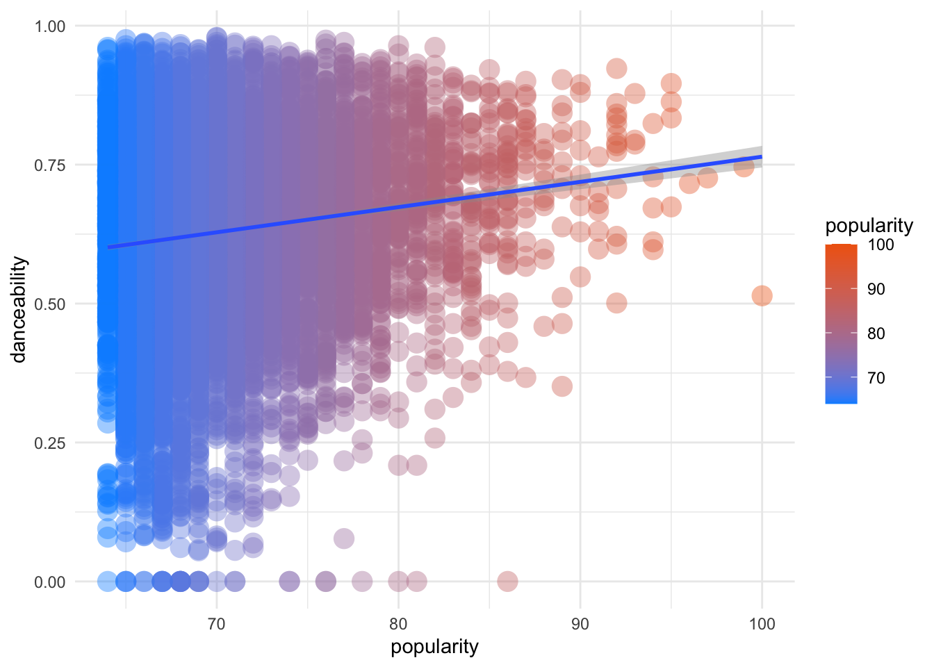
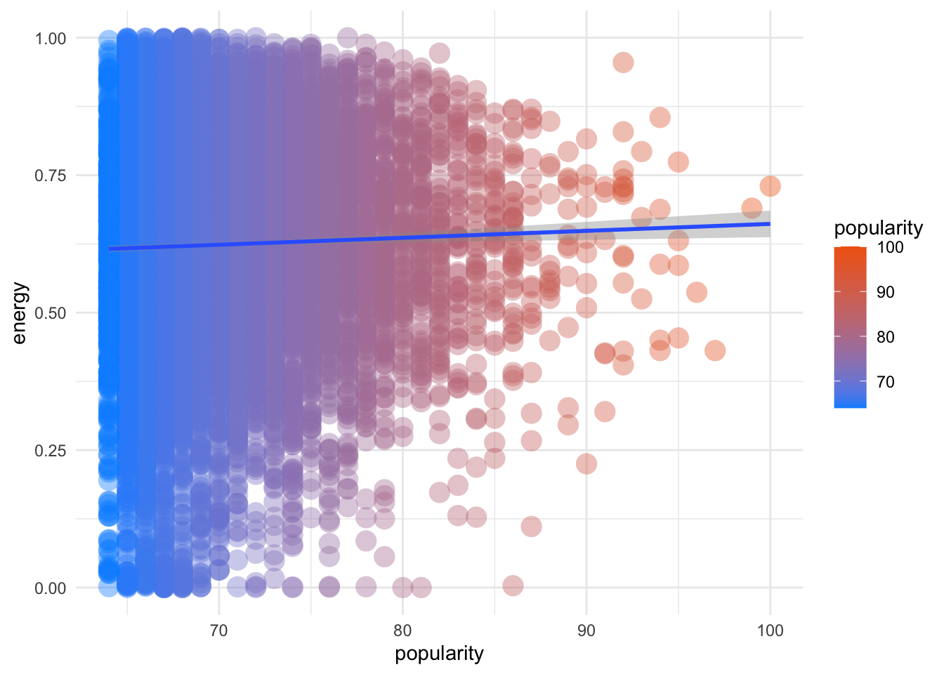
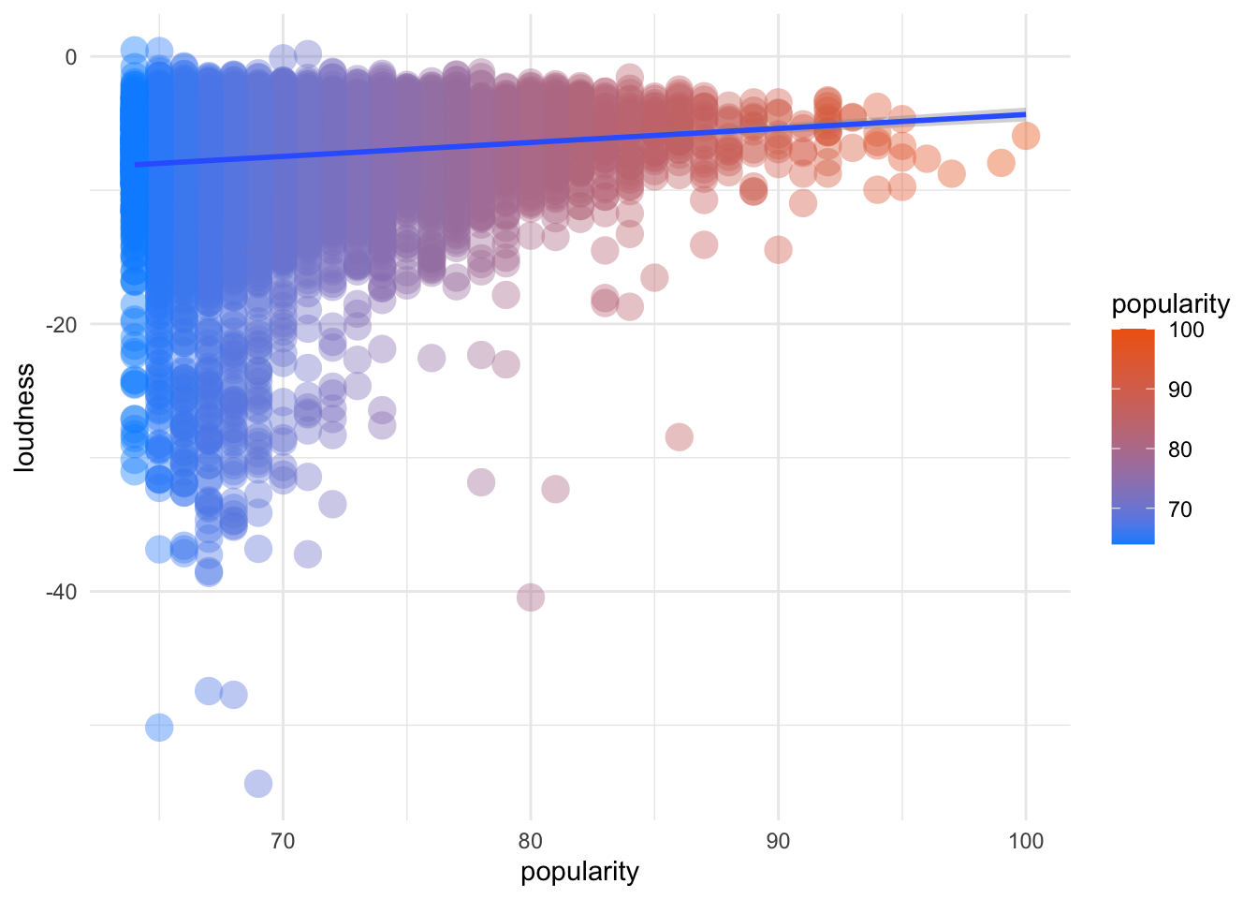
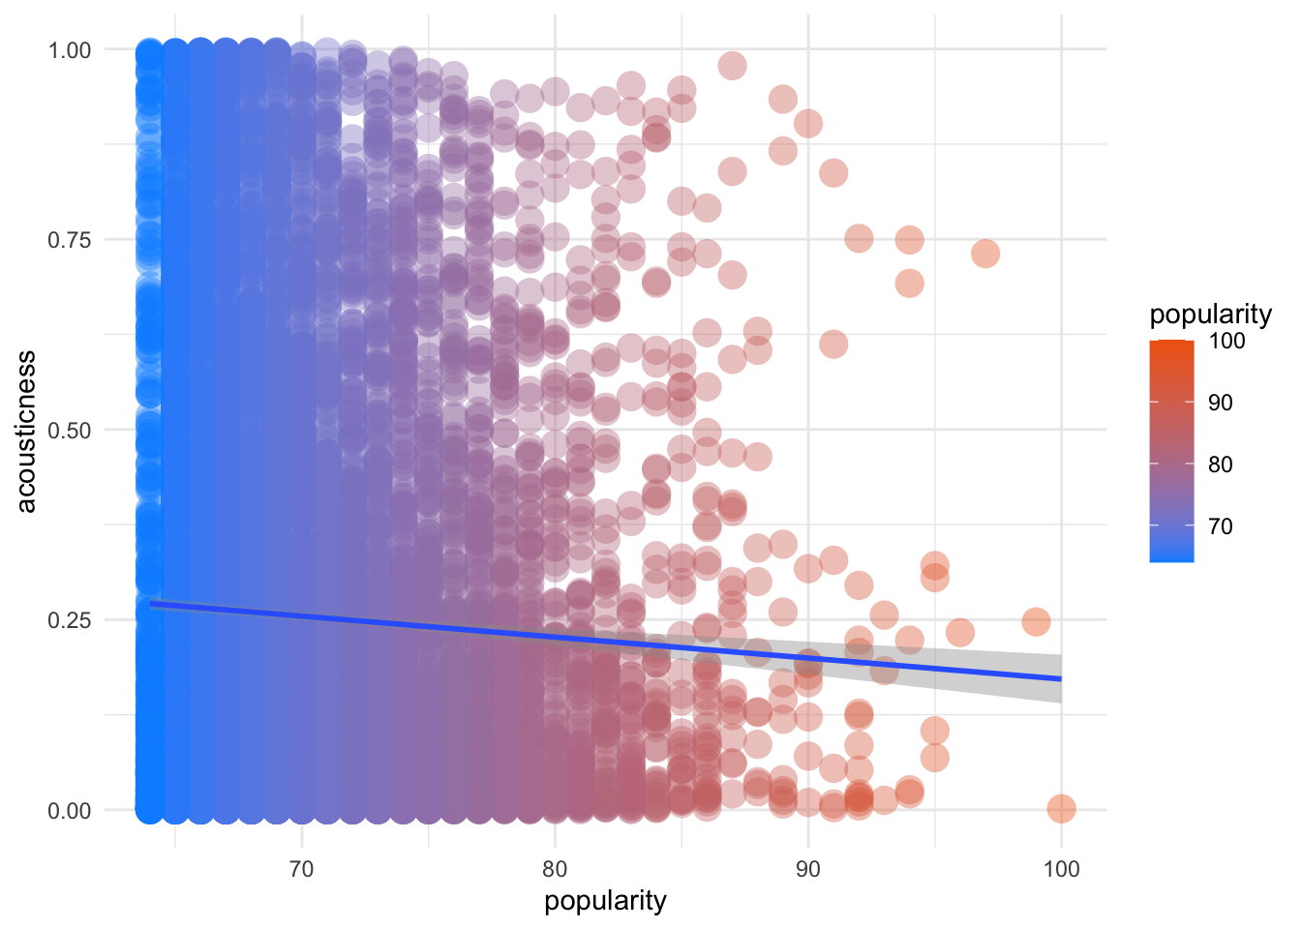
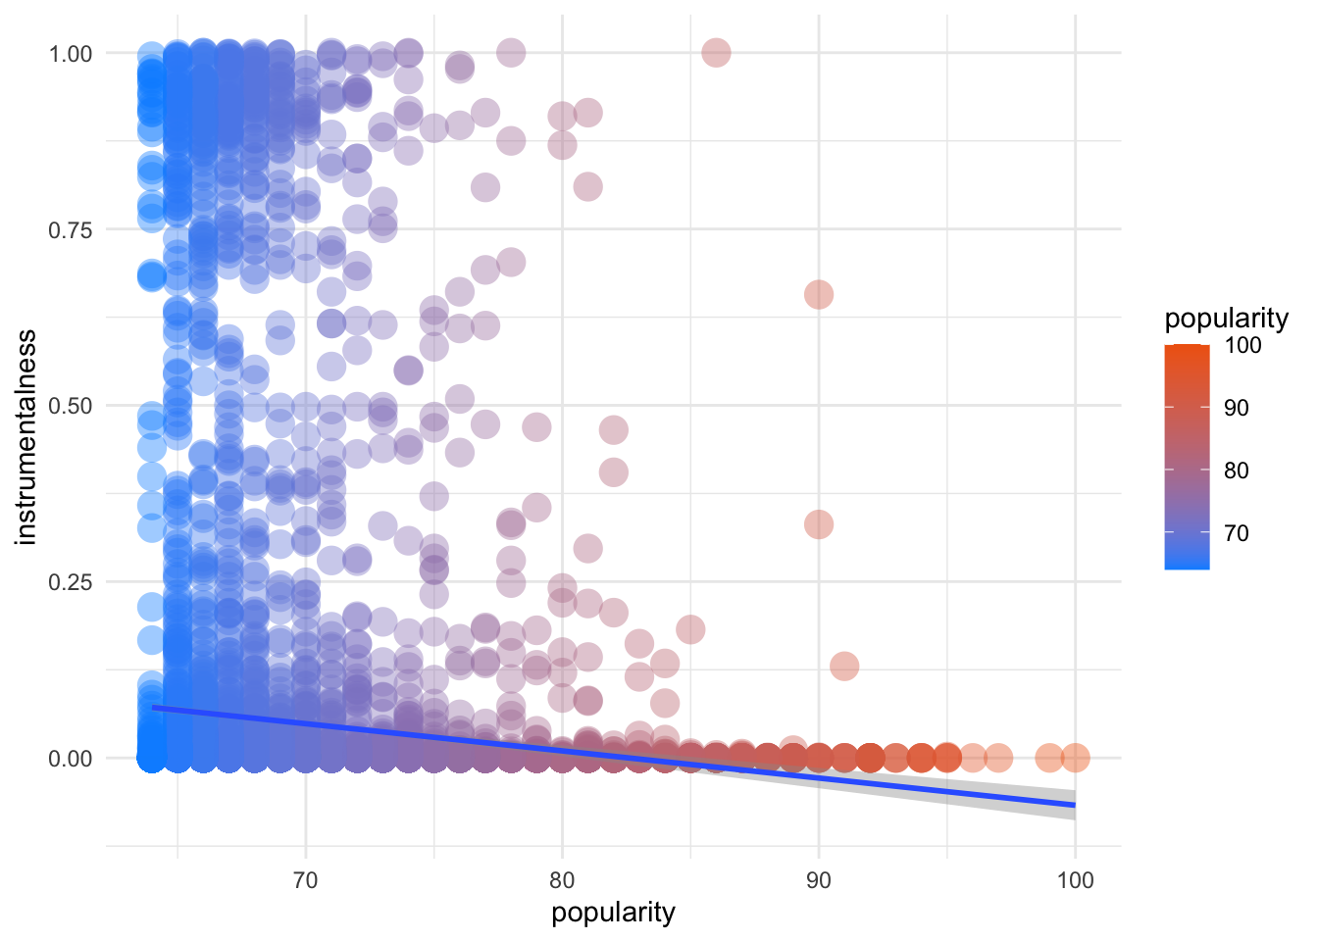
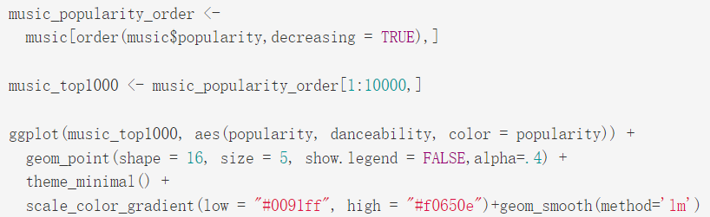
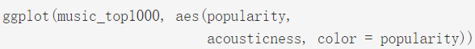
Attributes vs. Popularity
Positive effect
→ Danceability
→ Energy
→ Loudness
→ Acousticness
→ Instrumentalness
Negative effect
Code Review
Sentiment Analysis of Popular Songs' Lyrics
Group 16 : Fangru Linghu , Yiming Tan , Siyu Chen , Arun Mishra

Slide 10
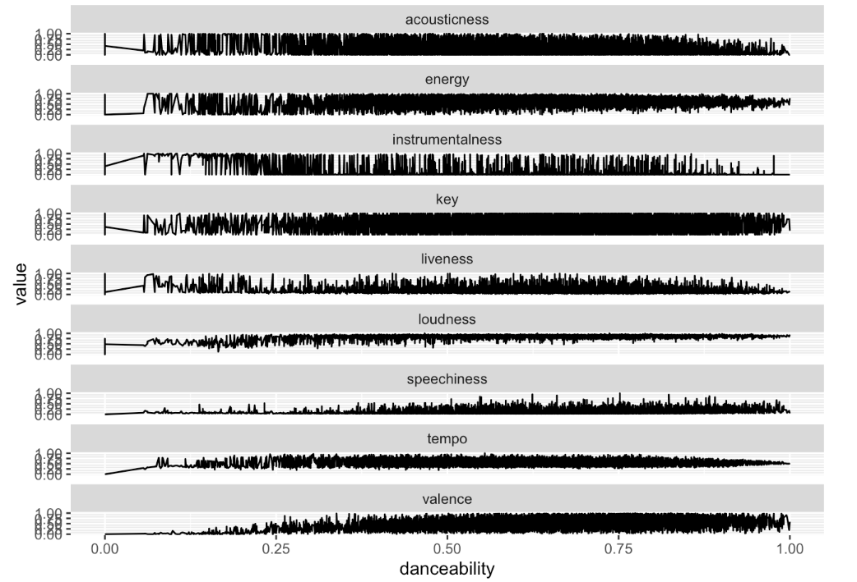
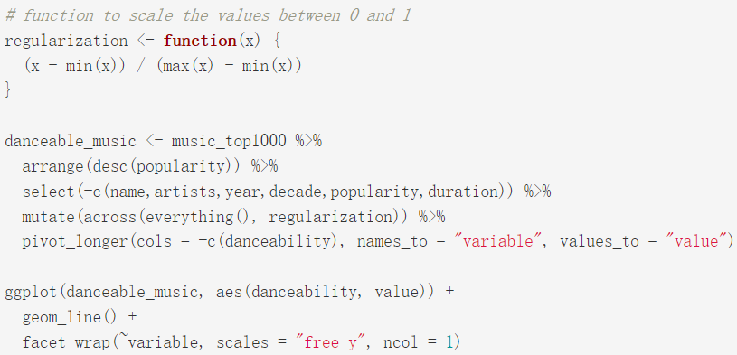
What Features are important for a song to be danceable?
Code Review
Sentiment Analysis of Popular Songs' Lyrics
Group 16 : Fangru Linghu , Yiming Tan , Siyu Chen , Arun Mishra

Slide 11
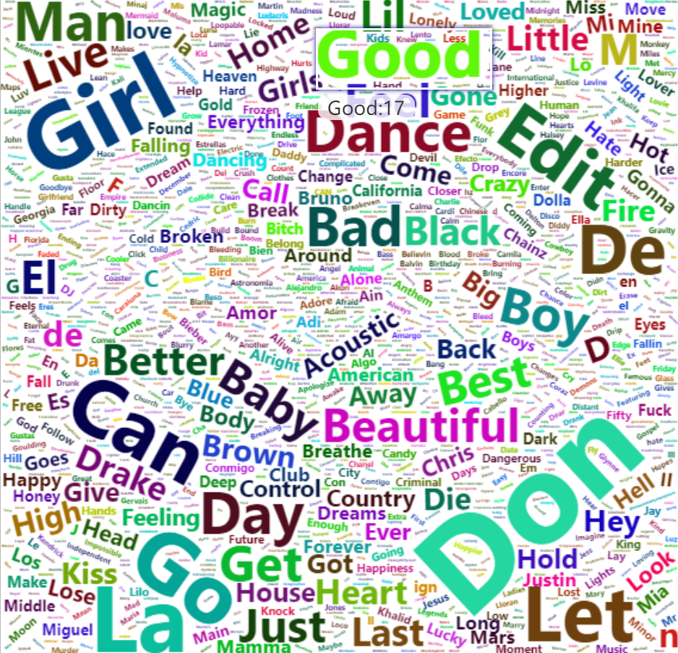
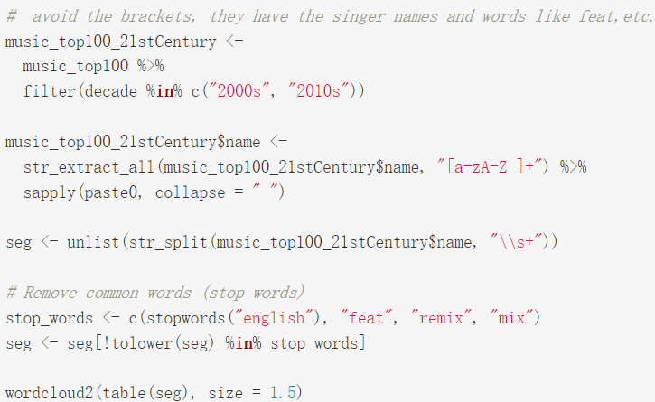
Most common words in title with a WordCloud
in 21st Century:
Girl : 24
Bad : 14
Code Review
Baby : 12
Don : 33
Sentiment Analysis of Popular Songs' Lyrics
Group 16 : Fangru Linghu , Yiming Tan , Siyu Chen , Arun Mishra

Slide 12
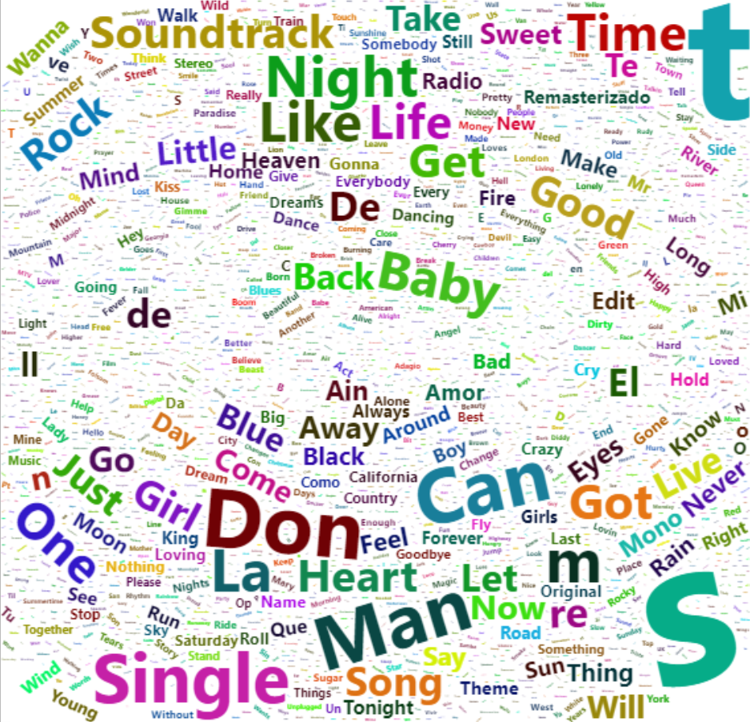
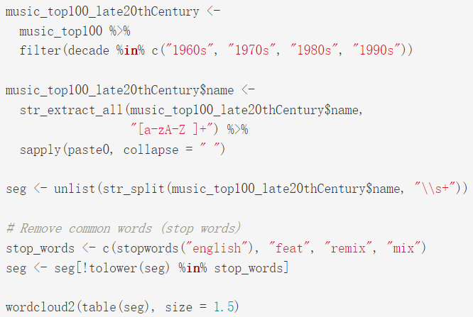
Most common words in title with a WordCloud
in late 20th Century:
Girl : 38
Baby : 12
Code Review
Don : 77
Sentiment Analysis of Popular Songs' Lyrics
Group 16 : Fangru Linghu , Yiming Tan , Siyu Chen , Arun Mishra

Slide 13
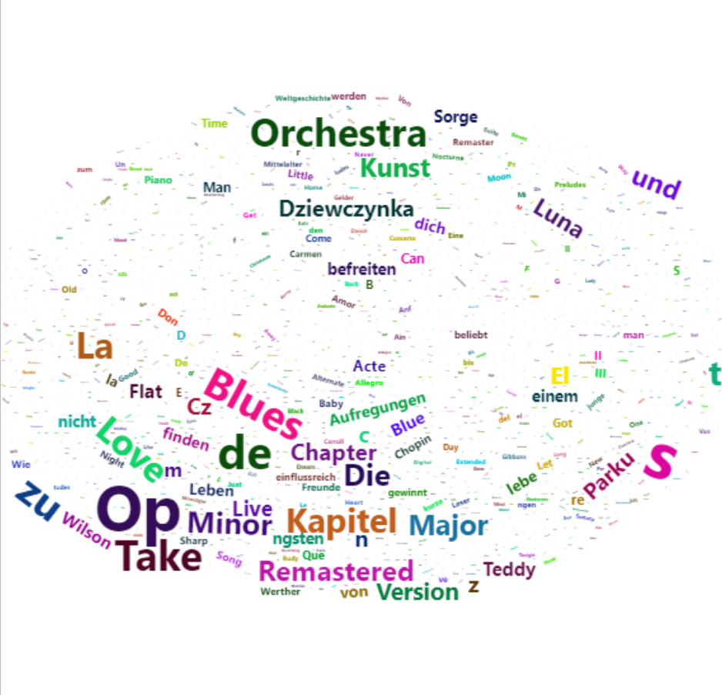
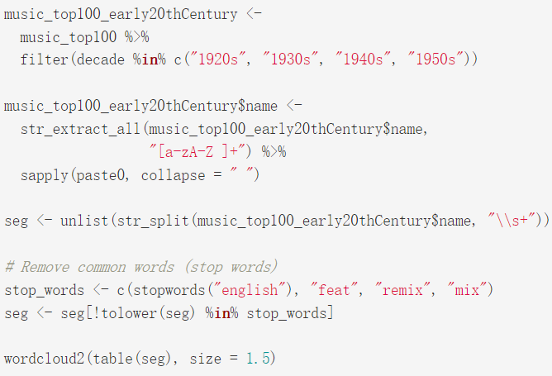
Most common words in title with a WordCloud
in early 20th Century:
Orchestra : 166
Code Review
Blue : 181
Take : 176
Sentiment Analysis of Popular Songs' Lyrics
Group 16 : Fangru Linghu , Yiming Tan , Siyu Chen , Arun Mishra

Slide 14
Summary
Common Characteristics of Popular Songs
lower acousticness
higher energy
less instrumentation
higher loudness
higher danceability
Significance of Project
These findings can help understand the changing trends in music over the years and the key factors contributing to a song's popularity.
However, it is essential to note that this analysis is based on a limited dataset and does not consider the complete landscape of the music industry.
Sentiment Analysis of Popular Songs' Lyrics
Group 16 : Fangru Linghu , Yiming Tan , Siyu Chen , Arun Mishra

Slide 15
Thank you for Listening !
Sentiment Analysis of Popular Songs' Lyrics
Group 16 : Fangru Linghu , Yiming Tan , Siyu Chen , Arun Mishra

